Slide 1

TeaStir
finding your perfect cup of tea
Nicolas, Yuting, Dinesh

Slide 2
Why, What , How
Numerous individuals out there who want to start drinking tea
Tea lovers who are seeking for new types of teas to try out.
Teastir solves this problem with the help of a short survey.

Slide 3
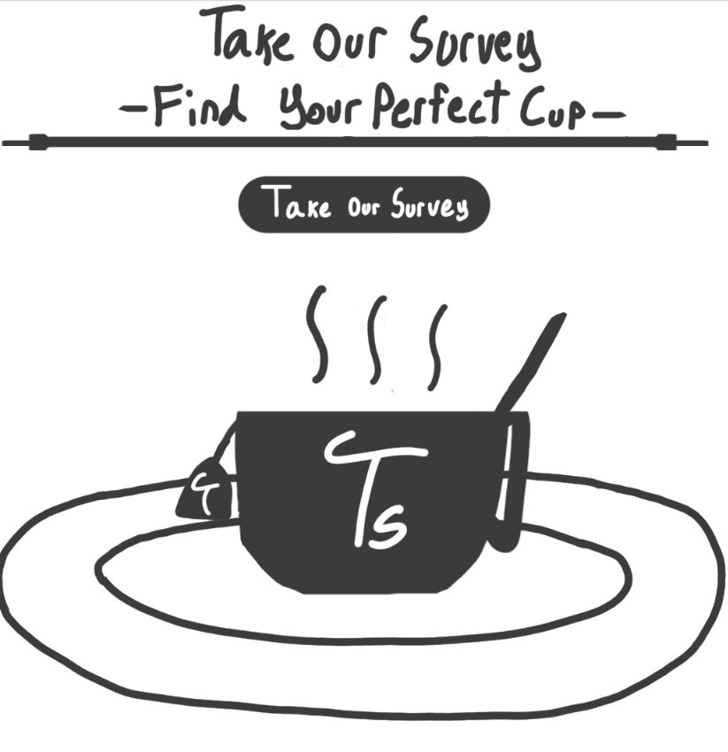
Why, What , How
Short survey requirements:
Pick the type of teas | flavors | caffeine level
Teastir solves this problem with the help of a short survey.
A short survey for users taste
An algorithm to analyze users preferences of teas
A database for matched teas in a close range
Recommending 3 teas based on their inputs

Slide 4
Roles & Responsibilities
Nicolas :
Main role was to focus on the front-end with the UI of the website design web pages such as logos, graphics and the designing algorithms
Yuting :
Main role was to deal with the user interaction with the site.
Dinesh:
Main role was to deal with Back-end database and algorithm

Slide 5
TeaStir Demo

Slide 6
Design Architecture & Team Management

Slide 7
MVC Model
Separation of concerns (Decoupling )
Easier to modify/evolve

Slide 8
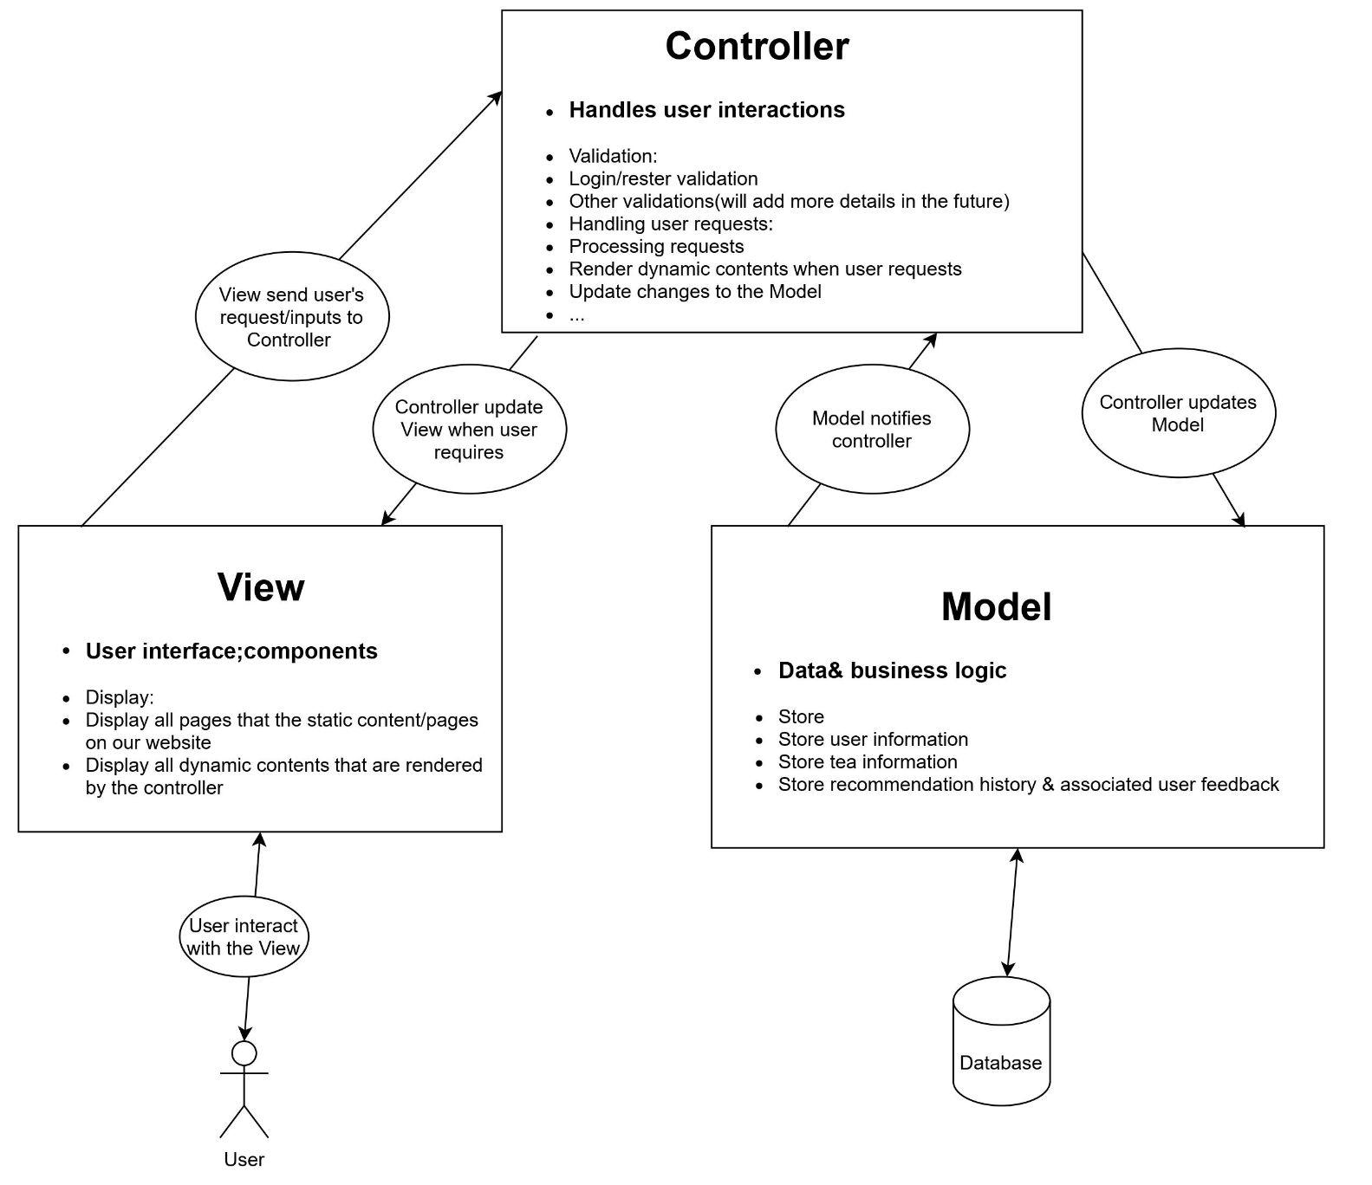
MVC Diagram

Slide 9
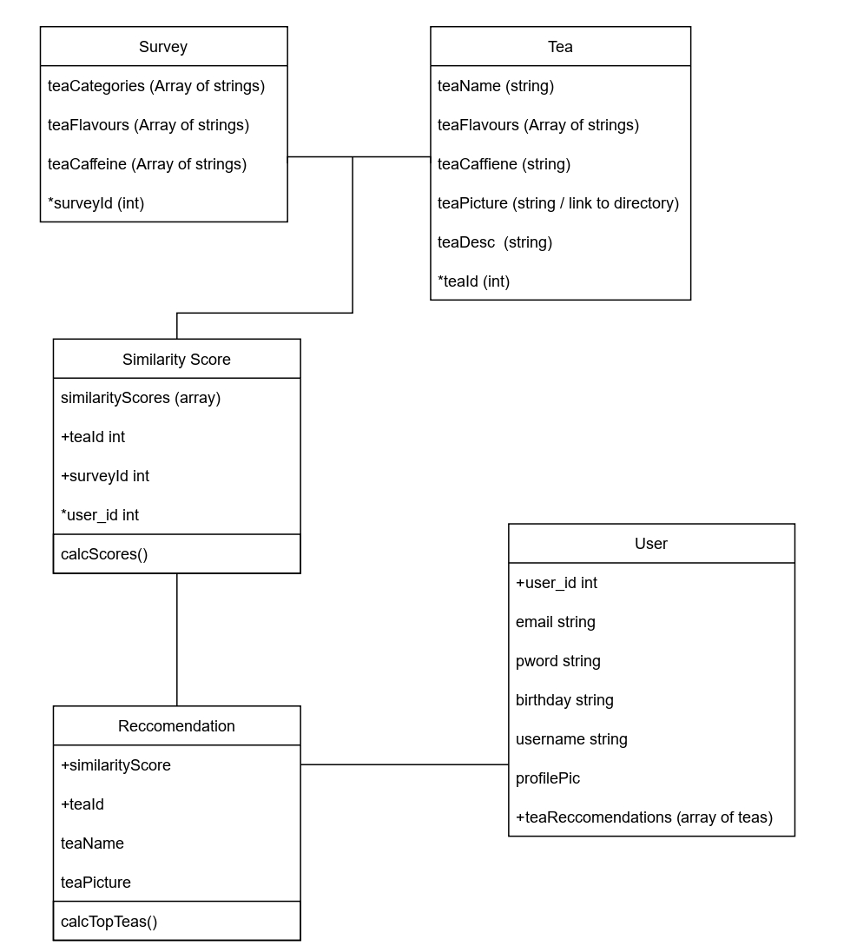
Class Diagram

Slide 10
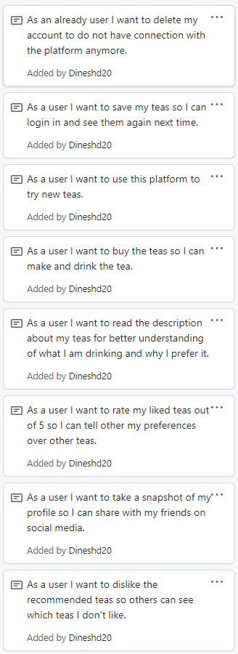
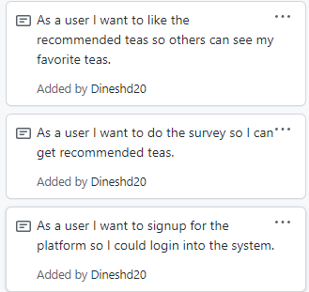

Slide 11
Feedback from Activity 4
Feedbacks
We used only “responsible” label for our Github project board
There are other labels such as “accountable” & “informed”
Github was messy
They should be sorted by activity/functionality

Slide 12
Reflection
We feel like we were successful with our project, and enjoyed having such a large scope and lots of freedom with our project, lots of other classes make you do a specific web-app or tech stack. We would have loved to have more time to spend on the coding portion of our project although we understand that the focus of the class was more on the project management side of things
We feel most proud of the uniqueness of our project and the polished design that we ended up with
In the future we would focus more on managing our tasks through our kanban board not just adding what we did after the fact
We will definitely be using Github moving forward and the kanban board for project tracking remotely and we also enjoyed the tech stack taught to us in the lab and would love to work with it more in the future

Slide 13
Thanks for listening

Slide 14
Teas data retrieved from david’s teas
https://www.davidstea.com/ca_en/home/

